Slide 1
PHYS4260 Quantum Mechanics II Spring 2025
Time-Independent Perturbation Theory
WKB approximation

Slide 2
Outline
Hyperfine structure of Hydrogen
The WKB Approximation:
Classical regions
Tunneling
Gamow’s theory of alpha decay
Scattering theory

Slide 3
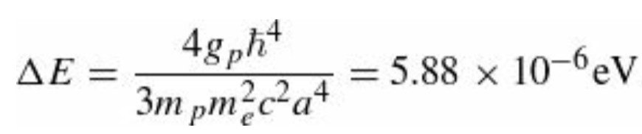
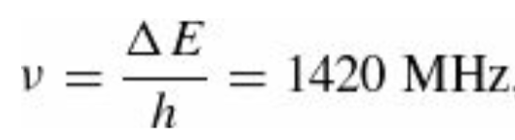
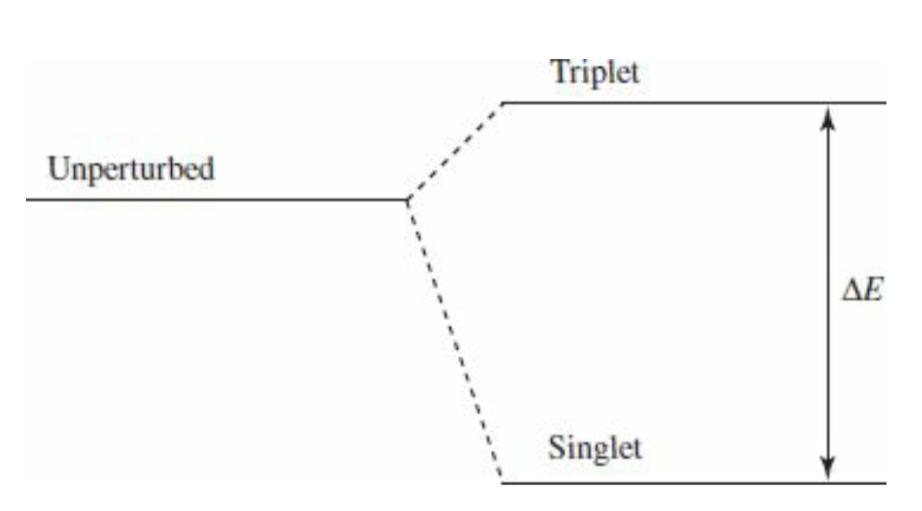
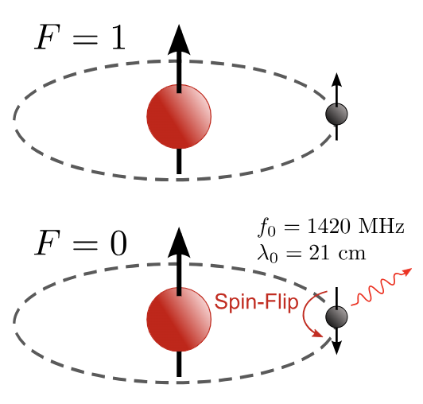
Re: Hyperfine splitting of the hydrogen atom
The energy gap is
The frequency of the photon emitted in a transition from the triplet to the singlet state is
The corresponding wavelength is 21cm, which falls in the microwave region. This famous 21cm line is among the most
pervasive forms of radiation in the universe.
A hydrogen atom with proton and electron spins aligned (top) undergoes a flip of the electron spin, resulting in emission of a photon with a 21 cm wavelength (bottom)

Slide 4
Hyperfine splitting of the hydrogen atom
An atom of neutral hydrogen consists of an electron bound to a proton. The lowest stationary energy state of the bound electron is called its ground state. Both the electron and the proton have intrinsic magnetic dipole moments ascribed to their spin, whose interaction results in a slight increase in energy when the spins are parallel, and a decrease when antiparallel. The fact that only parallel and antiparallel states are allowed is a result of the quantum mechanical discretization of the total angular momentum of the system.
When the spins are parallel, the magnetic dipole moments are antiparallel (because the electron and proton have opposite charge), thus one would expect this configuration to actually have lower energy just as two magnets will align so that the north pole of one is closest to the south pole of the other.
This logic fails here because the wave functions of the electron and the proton overlap; that is, the electron is not spatially displaced from the proton but encompasses it. The magnetic dipole moments are therefore best thought of as tiny current loops. As parallel currents attract, the parallel magnetic dipole moments (i.e., antiparallel spins) have lower energy.
The hyperfine splitting in hydrogen has been used to measure the value of the fine-structure constant α. Comparison with measurements of α in other physical systems provides a stringent test of QED.

Slide 5
The WKB (Wentzel, Kramers, Brillouin) Approximation

Slide 6
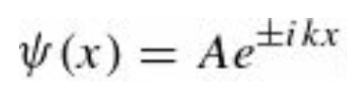
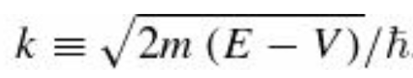
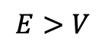
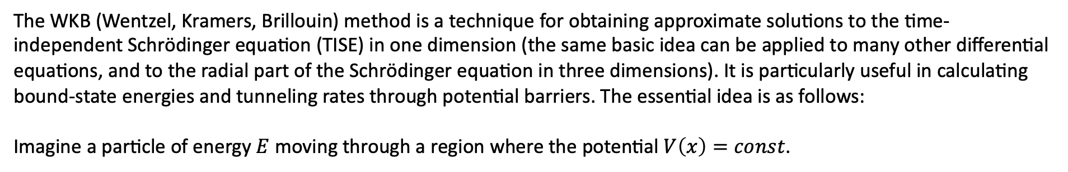
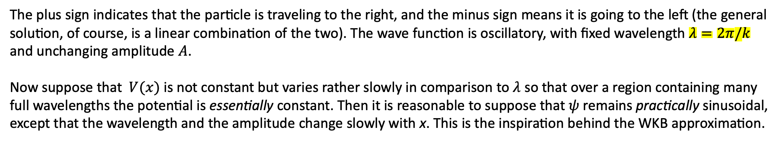
The WKB Approximation
The WKB (Wentzel, Kramers, Brillouin) method is a technique for obtaining approximate solutions to the time-independent Schrödinger equation (TISE) in one dimension (the same basic idea can be applied to many other differential equations, and to the radial part of the Schrödinger equation in three dimensions). It is particularly useful in calculating bound-state energies and tunneling rates through potential barriers. The essential idea is as follows:
Imagine a particle of energy $E$ moving through a region where the potential $V\left(x\right)=const$.
$$E>V$$
the wave function is of the form
The plus sign indicates that the particle is traveling to the right, and the minus sign means it is going to the left (the general solution, of course, is a linear combination of the two). The wave function is oscillatory, with fixed wavelength $λ=2π/k$
and unchanging amplitude $A$.
Now suppose that $V(x)$ is not constant but varies rather slowly in comparison to $λ$ so that over a region containing many full wavelengths the potential is essentially constant. Then it is reasonable to suppose that $ψ$ remains practically sinusoidal, except that the wavelength and the amplitude change slowly with x. This is the inspiration behind the WKB approximation.

Slide 7
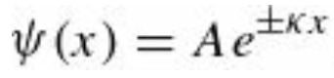
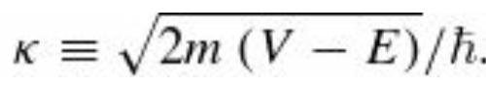
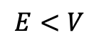
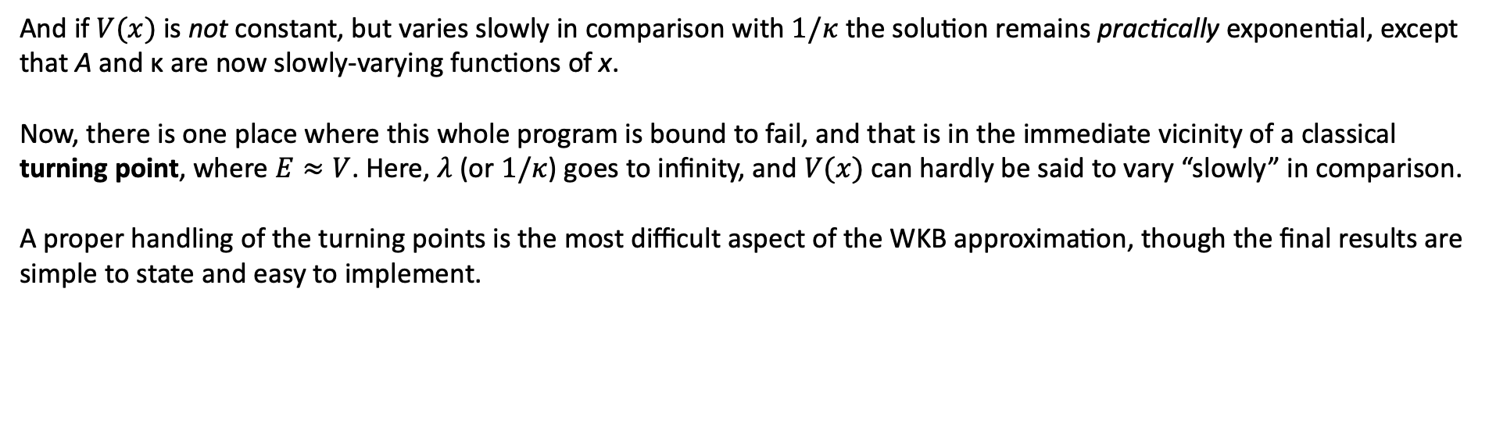
The WKB Approximation
By the same token, if
Reads: kappa
$$E<V$$
the wave function is exponential
And if $V(x)$ is not constant, but varies slowly in comparison with $1/κ$ the solution remains practically exponential, except that A and κ are now slowly-varying functions of x.
Now, there is one place where this whole program is bound to fail, and that is in the immediate vicinity of a classical turning point, where $E≈V$. Here, $λ$ (or $1/κ$) goes to infinity, and $V(x)$can hardly be said to vary “slowly” in comparison.
A proper handling of the turning points is the most difficult aspect of the WKB approximation, though the final results are simple to state and easy to implement.

Slide 8
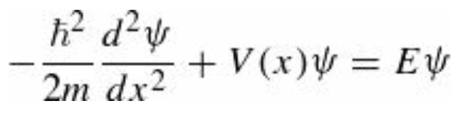
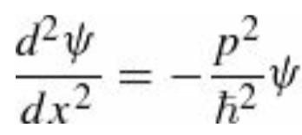
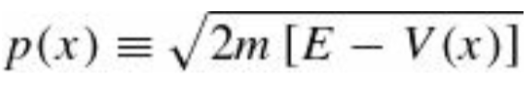
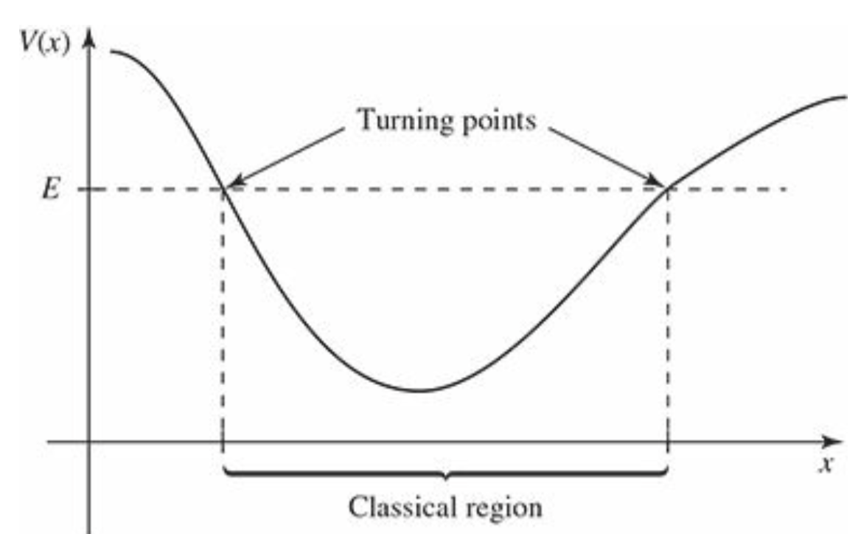
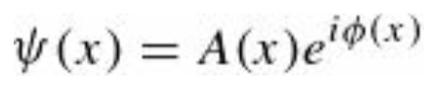
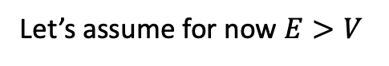
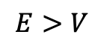
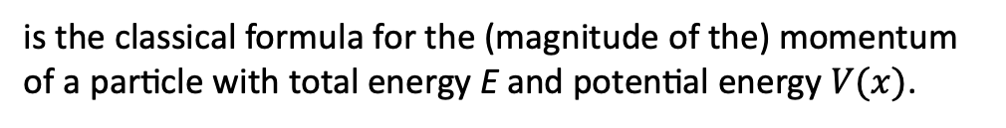
The WKB Approximation: Classical region
The Schrödinger equation,
can be written as
where:
is the classical formula for the (magnitude of the) momentum of a particle with total energy E and potential energy $V(x)$.
Let’s assume for now $E>V$
$$E>V$$
we call this the “classical” region, for obvious reasons—
classically the particle is confined to this range of x.
$A(x)$ and $φ(x)$ are both real and $ψ(x)$ is in general complex
Classically, the particle is confined to the region where $E>V$

Slide 9
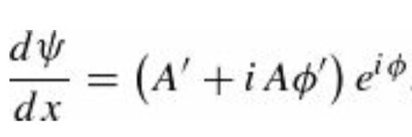
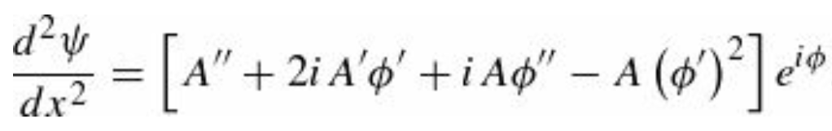
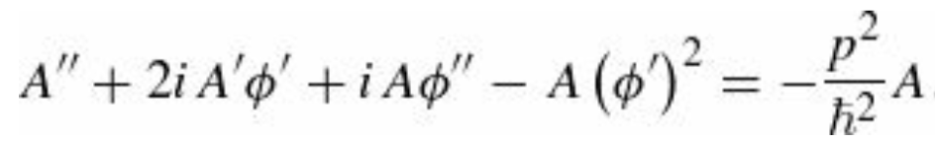
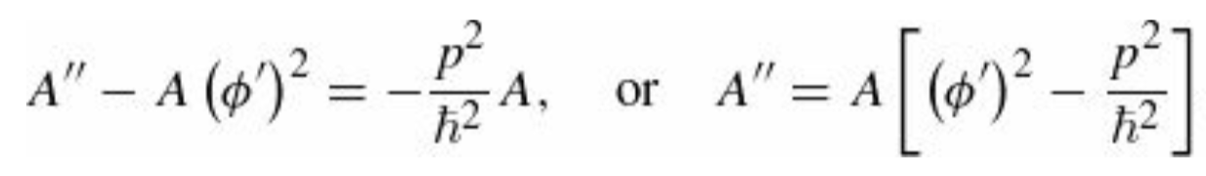
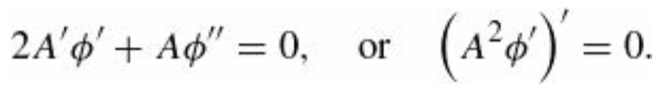
The WKB Approximation: Classical region
Using a prime to denote the derivative with respect to x,
and
Substituting this into the TISE will give
This is equivalent to two real equations, one for the real part and one for the imaginary part:
(Real)
(Imaginary)

Slide 10
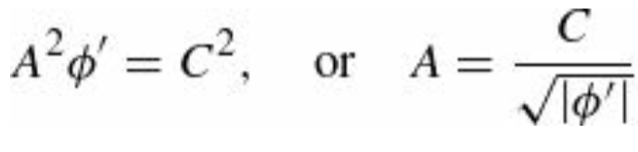
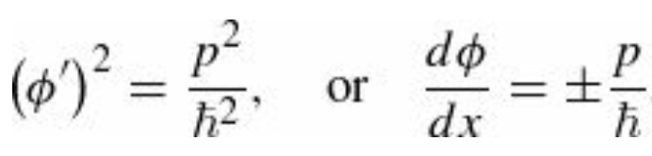
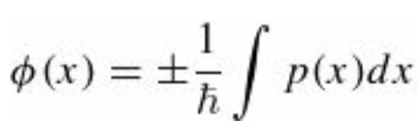
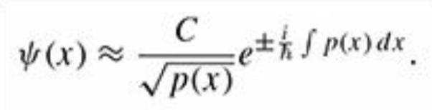
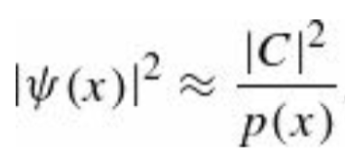
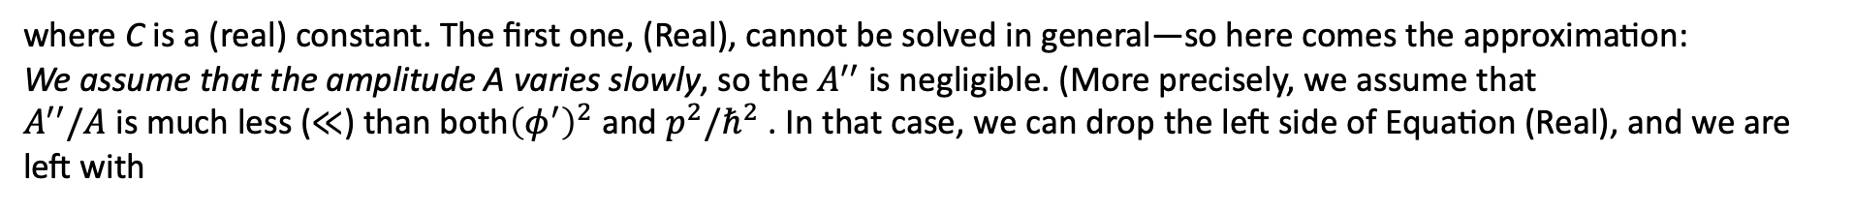
The WKB Approximation: Classical region
Eqns. (Real) and (Imaginary) are entirely equivalent to the original Schrödinger equation. The second, (Imaginary), is
easily solved:
where C is a (real) constant. The first one, (Real), cannot be solved in general—so here comes the approximation:
We assume that the amplitude A varies slowly, so the $A^{′′}$ is negligible. (More precisely, we assume that
$A^{′′}/A$ is much less ($≪$) than both${\left(φ^{′}\right)}^{2}$ and $p^{2}/ℏ^{2}$ . In that case, we can drop the left side of Equation (Real), and we are left with
Let us write this as an indefinite integral, for now—any constant of integration can be absorbed into C, which thereby
becomes complex. I’ll also absorb a factor of $\sqrt{ℏ}$ . Then
with

Slide 11
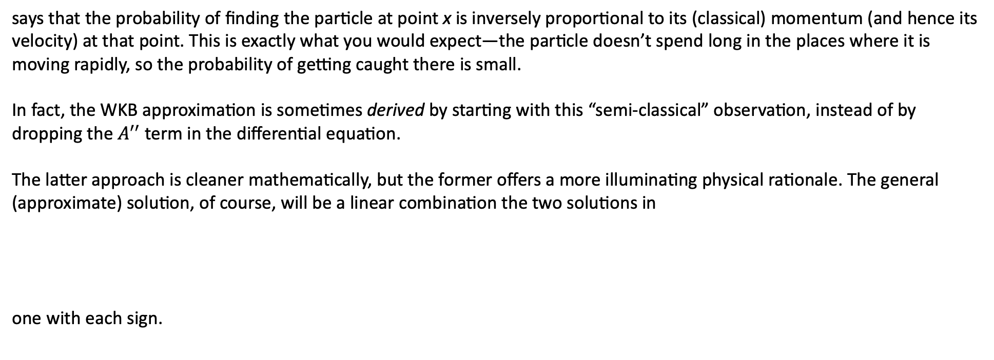
The WKB Approximation: Classical region
says that the probability of finding the particle at point x is inversely proportional to its (classical) momentum (and hence its velocity) at that point. This is exactly what you would expect—the particle doesn’t spend long in the places where it is moving rapidly, so the probability of getting caught there is small.
In fact, the WKB approximation is sometimes derived by starting with this “semi-classical” observation, instead of by dropping the $A^{′′}$ term in the differential equation.
The latter approach is cleaner mathematically, but the former offers a more illuminating physical rationale. The general (approximate) solution, of course, will be a linear combination the two solutions in
one with each sign.

Slide 12
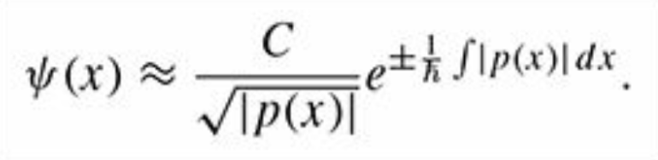
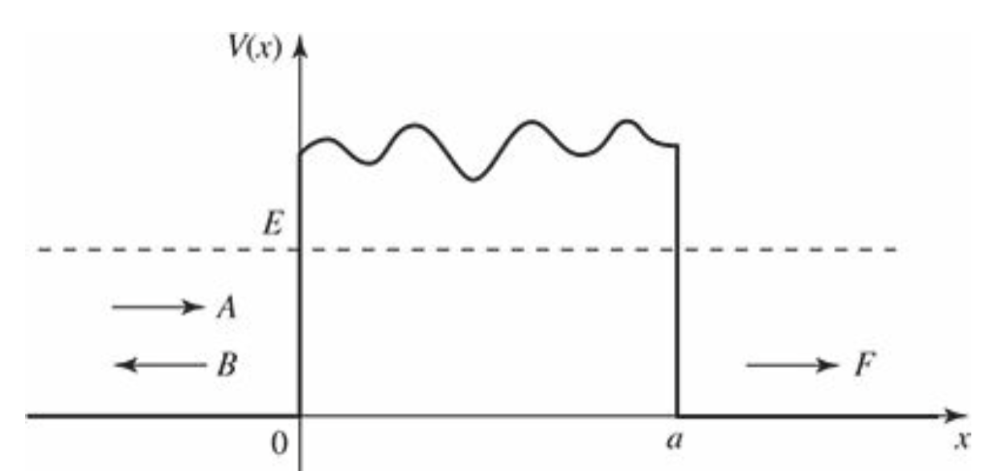
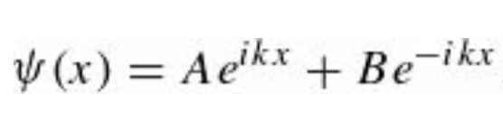
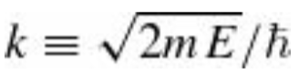
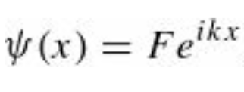
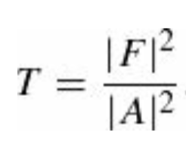
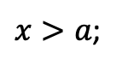
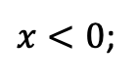
The WKB Approximation: Tunneling
So far, we have assumed that $E> V$ so $p(x)$ is real. But we can easily write down the corresponding result in the non-classical region $E< V$. It’s the same as before, but now $p(x)$ is imaginary
Consider, for example, the problem of scattering from a rectangular barrier with a bumpy top.
$x<0$;
where A is the incident amplitude, B is the reflected amplitude
$x>a$;
where F is the transmitted amplitude. The transmission probability is

Slide 13
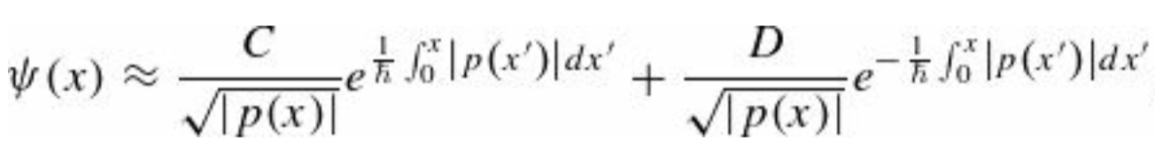
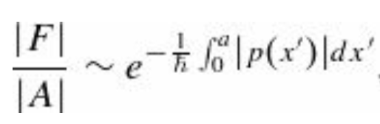
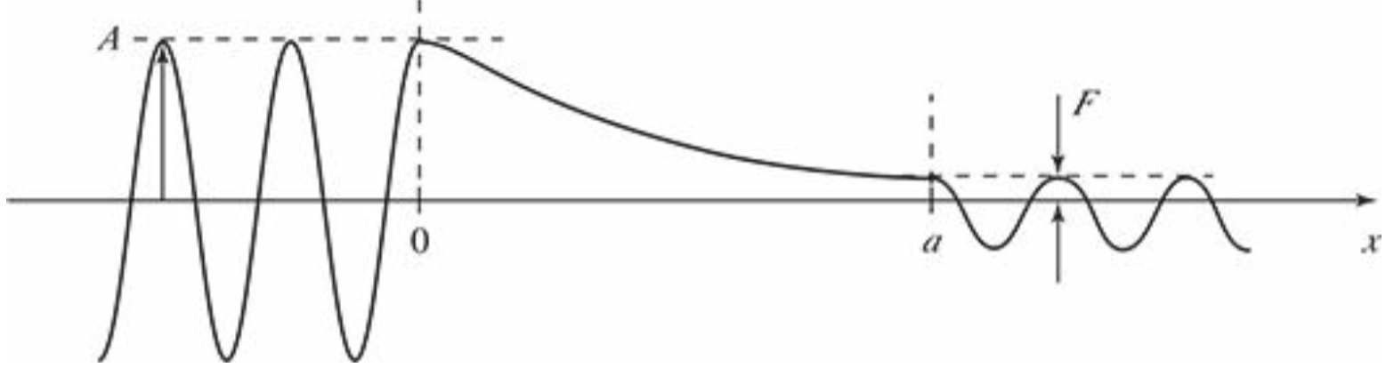
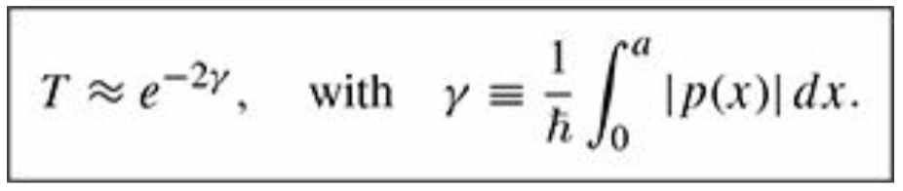
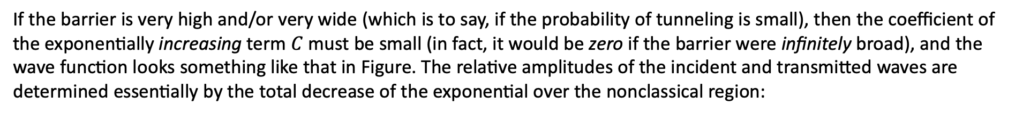
The WKB Approximation: Tunneling
In the tunneling region $0≤x≤a$ the WKB approximation gives
If the barrier is very high and/or very wide (which is to say, if the probability of tunneling is small), then the coefficient of the exponentially increasing term $C$ must be small (in fact, it would be zero if the barrier were infinitely broad), and the wave function looks something like that in Figure. The relative amplitudes of the incident and transmitted waves are determined essentially by the total decrease of the exponential over the nonclassical region:

Slide 14
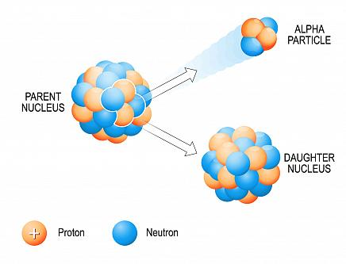
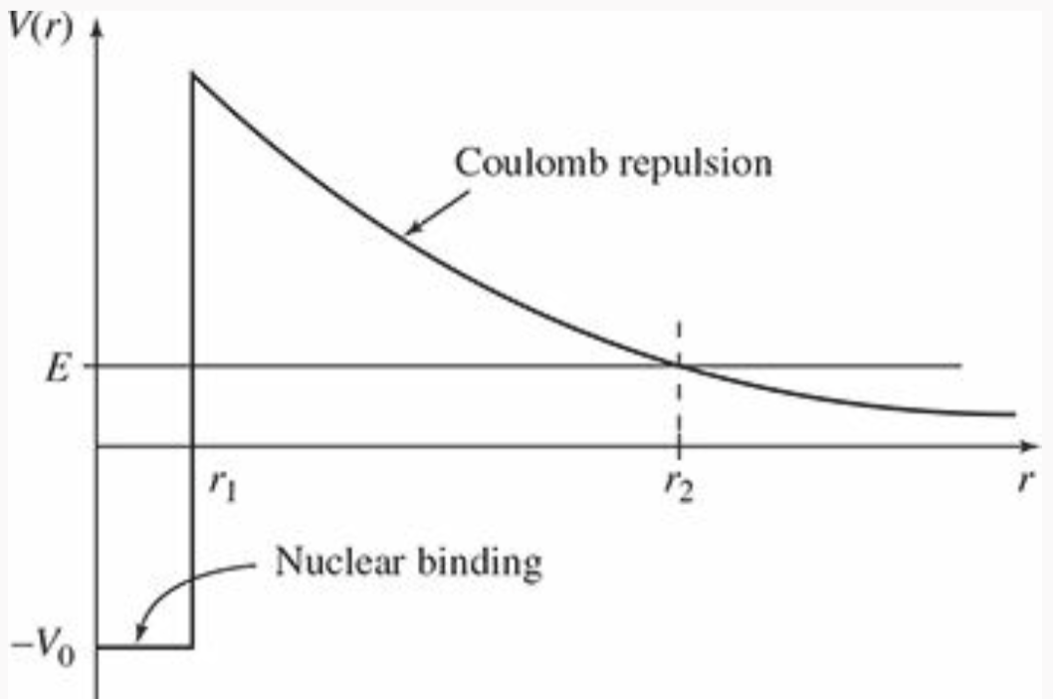
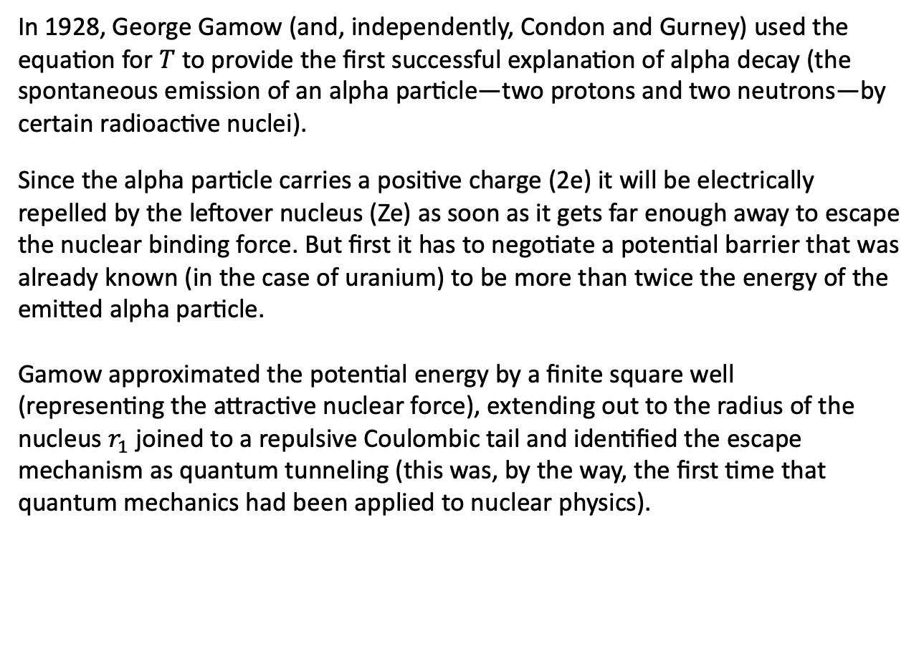
Example: Gamow’s theory of alpha decay
In 1928, George Gamow (and, independently, Condon and Gurney) used the equation for $T$ to provide the first successful explanation of alpha decay (the spontaneous emission of an alpha particle—two protons and two neutrons—by certain radioactive nuclei).
Since the alpha particle carries a positive charge (2e) it will be electrically repelled by the leftover nucleus (Ze) as soon as it gets far enough away to escape the nuclear binding force. But first it has to negotiate a potential barrier that was already known (in the case of uranium) to be more than twice the energy of the emitted alpha particle.
Gamow approximated the potential energy by a finite square well
(representing the attractive nuclear force), extending out to the radius of the nucleus $r_{1}$ joined to a repulsive Coulombic tail and identified the escape mechanism as quantum tunneling (this was, by the way, the first time that quantum mechanics had been applied to nuclear physics).

Slide 15
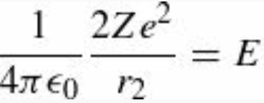






Example: Gamow’s theory of alpha decay
If E is the energy of the emitted alpha particle, the outer turning point $r_{2}$ is determined by
The integral can be done by substitution $r=r_{2}{(sin{u})}^{2}$
Typically, $r_{1}≪ r_{2}$ and we can simplify this result using the small angle approximation $\sin{ε}≈ε$
where
and

Slide 16





Example: Gamow’s theory of alpha decay
1fm$={10}^{−15}$ m is the size of a typical nucleus. If we imagine the alpha particle rattling around inside the nucleus, with an
average velocity v, the time between “collisions” with the “wall” is about $t=2 r_{1}/v$ and hence the frequency of collisions is
$f=1/t$. The probability of escape at each collision is $e^{−2γ}$ so the probability of emission, per unit time, is
$P={f e}^{−2γ}=v/(2 r_{1})$ $e^{−2γ}$
and hence the lifetime of the parent nucleus is about
$τ=\frac{1}{P}= (2 r_{1})/v$ $e^{2γ}$
Unfortunately, we don’t know v—but it hardly matters: the exponential factor varies over a fantastic range
(twenty-five orders of magnitude), as we go from one radioactive nucleus to another; relative to this, the variation in v
is insignificant. In particular, if you plot the logarithm of the experimentally measured lifetime against $1/\sqrt{E}$
the result is a beautiful straight line just as you would expect from the above Eqns.
Recap: Exponential decay of a sample $N_{t}$ nuclei. The decay constant 𝜆, the average lifetime 𝜏 and the
half-life $t_{1/2}$ are connected
= Half-life

Slide 17

Example: Gamow’s theory of alpha decay
Graph of the logarithm of the half-life $τ_{1/2}=τ ln⁡(2)$ vs $1/\sqrt{E}$ (where E is the energy of the emitted alpha particle),
for isotopes of uranium and thorium.

Slide 18
Scattering theory

Slide 19

Scattering theory: Classical
Imagine a particle incident on some scattering center (say, a marble bouncing off a bowling ball, or a proton fired at a heavy nucleus). It comes in with energy E and impact parameter b, and it emerges at some scattering angle θ—see Fig. (We’ll assume for simplicity that the target is symmetrical about the z axis, so the trajectory remains in one plane, and that the target is very heavy, so its recoil is negligible.) The essential problem of classical scattering theory is this:
Given the impact parameter, calculate the scattering angle.
Ordinarily, of course, the smaller the impact parameter, the greater the scattering angle.

Slide 20






Scattering theory: Classical
More generally, particles incident within an infinitesimal patch of cross-sectional area $dσ$ will scatter into a corresponding infinitesimal solid angle $dΩ$. The proportionality factor is a function of angle $θ$: $D\left(θ\right)=dσ/dΩ$
$$D\left(θ\right)=dσ/dΩ$$
In terms of the impact parameter and the azimuthal angle $φ$ and
Since θ is typically a decreasing function of b,
the derivative is actually negative—hence the
absolute value sign.

